Slide 1
United States Police Shootings (2015-2020)
By Yash Pise, Salvatore Scire, Vidisha Bardekar, Dishti Soni, and Aishwarya Tikare
Notes:
Vid

Slide 2
Agenda
Introduction
Dataset
Visualization
Police shooting of Victims using Race
Racial Distribution of Victims ( Unarmed )
Gender Distribution
Age
Number of Police Shootings ( 2015-2020 )
Most Common Weapons used
Distribution of armed and unarmed victims
Victims with Mental Illness
Citywise Police Killings
ANOVA Regressions
Conclusion
Notes:
Vid

Slide 3
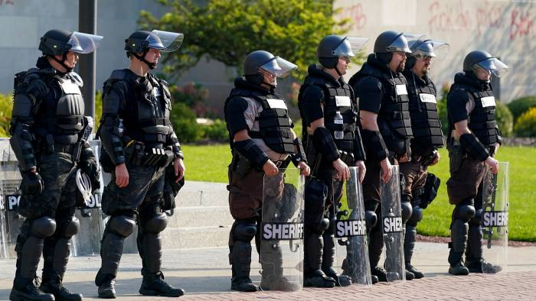
Purpose
The purpose of our analysis was to primarily discover if race followed by being armed and political party in power was a factor in the variation of police shootings in the United States from 2015 to 2020.
The secondary purpose of our analysis was finding facts on gender, age, weapon type, and mental illness.
Notes:
Vid

Slide 4
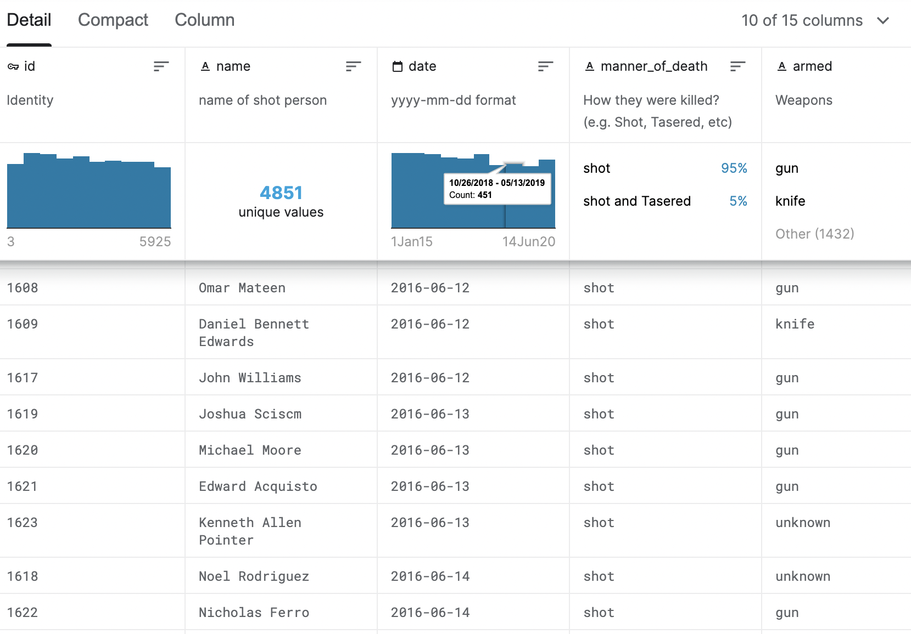
Dataset
Number of Rows : 4851
Number of Columns: 15
Our dataset consists of nominal, ratio, categorical attributes such as:
Name
Age
Gender
Race
City
State
Armed/Unarmed
Notes:
Vid

Slide 5
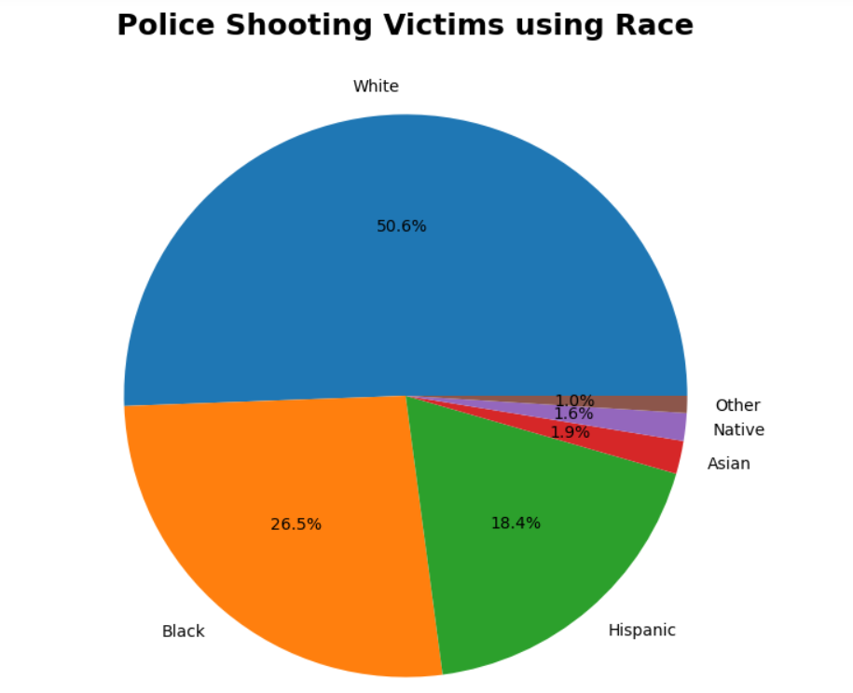
Visualization 1: Race
We can see that 50% of the people shot are white and 26% of people are black followed by 18% of people are hispanic.
While white people make up half the population of victims shot, there is some disproportions in the percentage of total populations by race.
Later, we are going to dig deeper into the difference among the races with a highlight on Whites, Blacks, and Hispanics.
Notes:
Dishti: As we can see here whites have been victims of police shootings the most. When it comes to being unarmed, there is clear discrepancy between the number of total blacks shot and the total of number of unarmed black shots.

Slide 6
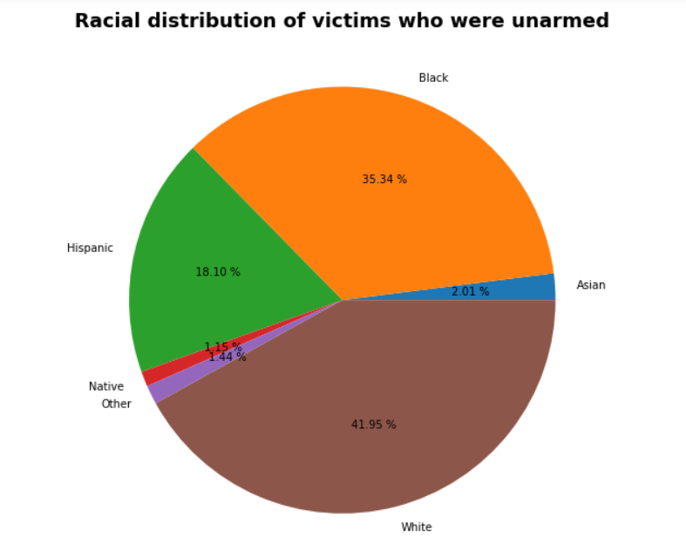
Visualization 2: Racial Distribution of Victims (Unarmed)
42% of unarmed victims were white, followed by 35% black and 18% hispanic.
Considering the population of the United States, the count of unarmed black and hispanic is higher
Out of 100 victims, 6 were unarmed victims for a total 318 unarmed individuals.
Notes:
Dishti:
Rates among unarmed Black and Hispanic victims were significantly higher than they were among White victims: more than 3 times as high and 45% higher, respectively.
Unarmed victims were also younger than the overall victim pool.

Slide 7
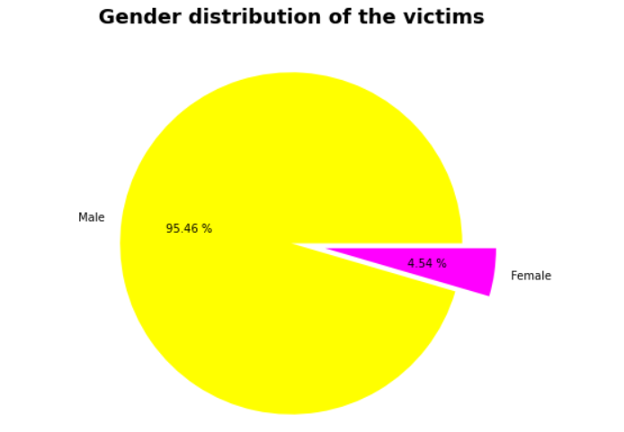
Visualization 3: Gender Distribution
It is evident that 95% of victims are male and 5% of victims are female.
This is not a surprise as males are known to be more violent than females
Notes:
Dishti: There is no surprise here that males have been shot almost entirely over females

Slide 8
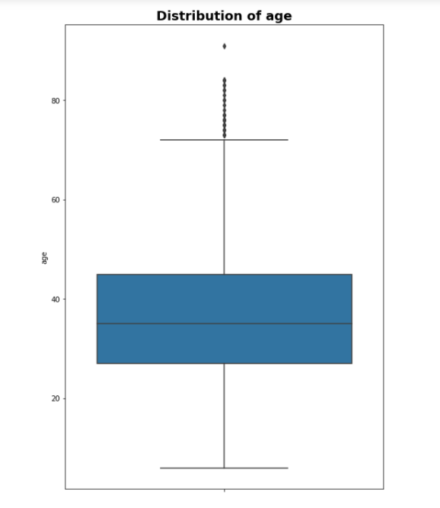
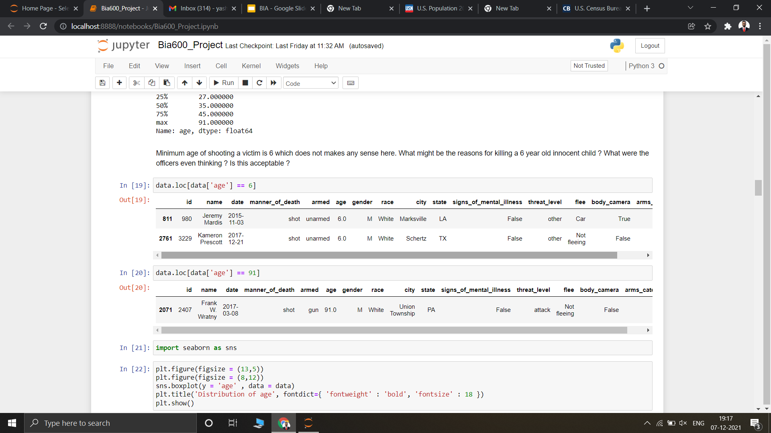
Visualization 4: Age
For both men and women, and across all racial and ethnic groupings, the risk of being killed by police peaks between the ages of 25 and 45.
The minimum age shot was 6 years old; unarmed, which was severely unacceptable.
Notes:
We can see the majority of people shot were in the 25-45 range, with total police shootings slowly declining. The sharp spike it shootings for 2020 was a factor of COVID-19

Slide 9
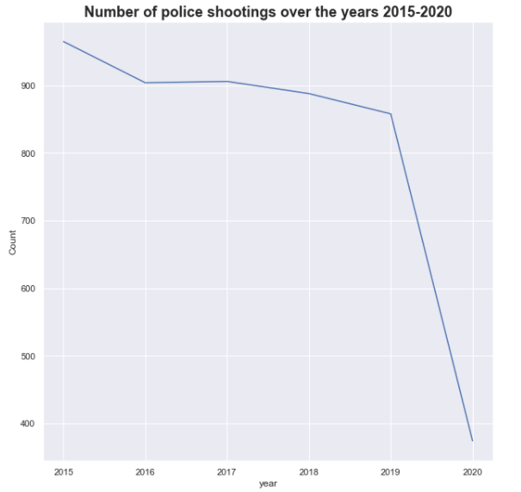
Visualization 5: Number of Police Shootings (2015-2020)
According to the chart, the United States has an average between 850 - 950 shootings per year.
The chart is slightly decreasing from 2015-2019, which is a good sign.
Note data from second half of 2020 is incomplete.

Slide 10
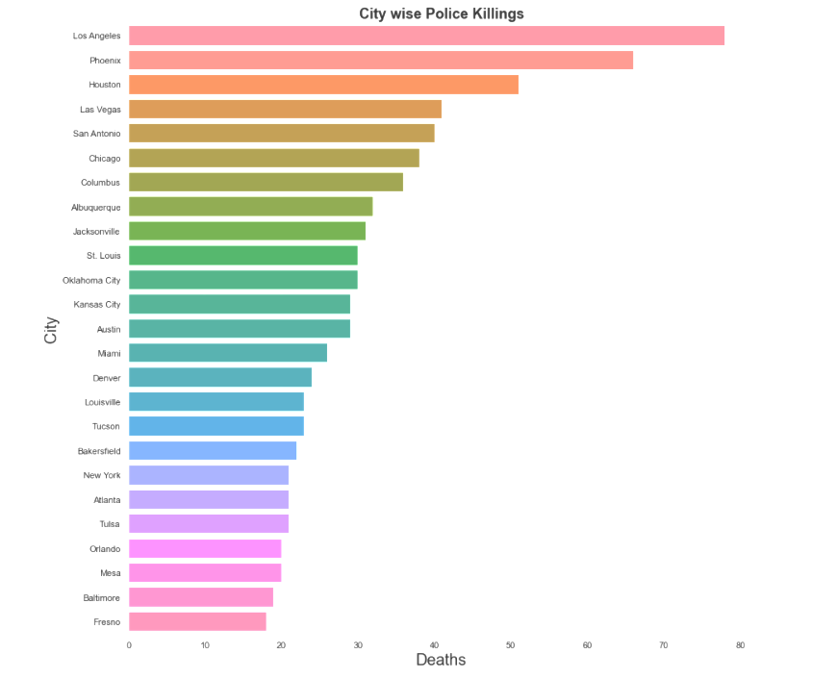
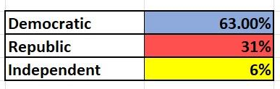
Visualization 6: Citywise Police Killings
Police shootings have taken place in every state and have occurred more frequently in cities where populations are concentrated.
From the analysis, states with the highest rates of shootings are LA, Phoenix and Houston.
Notes:
LA, Phoenix, and Houston have the most shootings

Slide 11
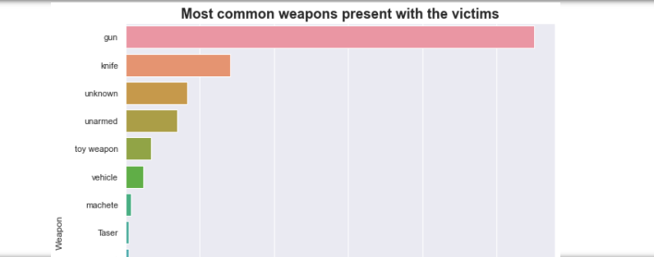
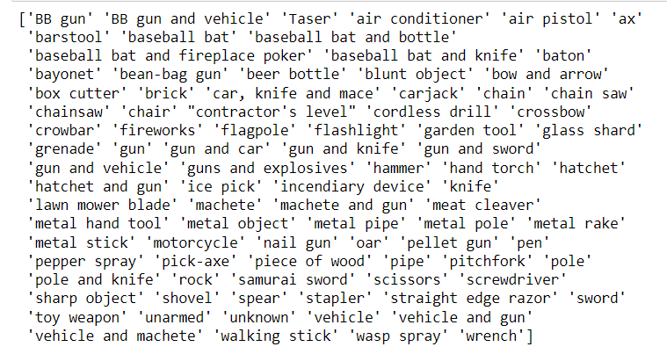
Visualization 7: Most common weapons used
In the United States, guns are the most commonly used weapon in shootings followed by knives.
"The pen is mightier than the sword," they say, but is the pen actually considered a weapon? That's Shocking!
Notes:
There is no surprise here that the most victims were shot by a gun.

Slide 12
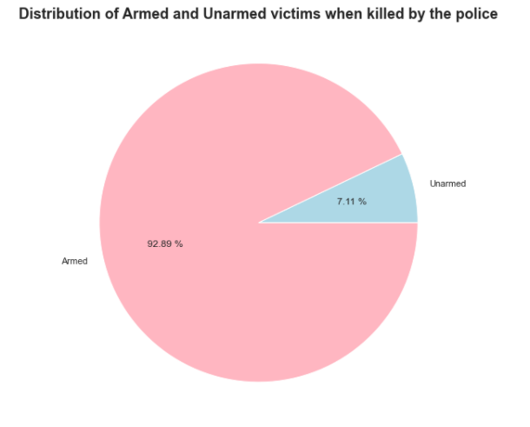
Visualization 8: Distribution of Armed and Unarmed Victims
Instances shows more of police killings that were objectively reasonable, with 93% of victims being armed compared to 7% unarmed.
The limited data that was available to us, we cannot determine the exact reasons for killing, yet still we can conclude that armed victims are more likely to be killed by police than unarmed victims.
Notes:
This data makes sense as you would expect more people who were armed to be shot than people who were unarmed

Slide 13
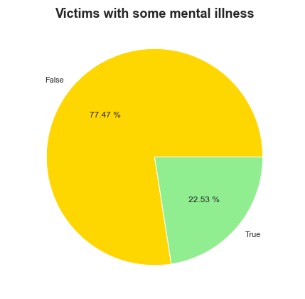
Visualization 9: Mental Illness
The chart reveals that 77% of victims did not have mental illness where 23% of victims did have mental illness.
We can conclude that 23 out of 100 victims were mentally ill.

Slide 14
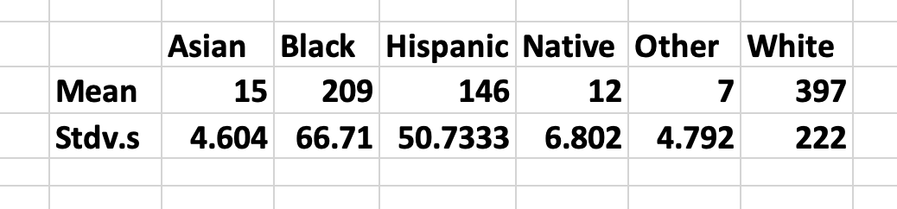
Mean & Stdv.s

Slide 15
ANOVA Regression Intro:
Before running our regression, we struggled to find answers using just the individuals shot per year.
Total individuals shot by race per year and divide each number by the total United States population of each race per year.
These are the numbers reflected in the ANOVA analysis.
ANOVA: Null: Are all the averages of total shootings per race the same (bias) or Alt: are they different (not bais).

Slide 16
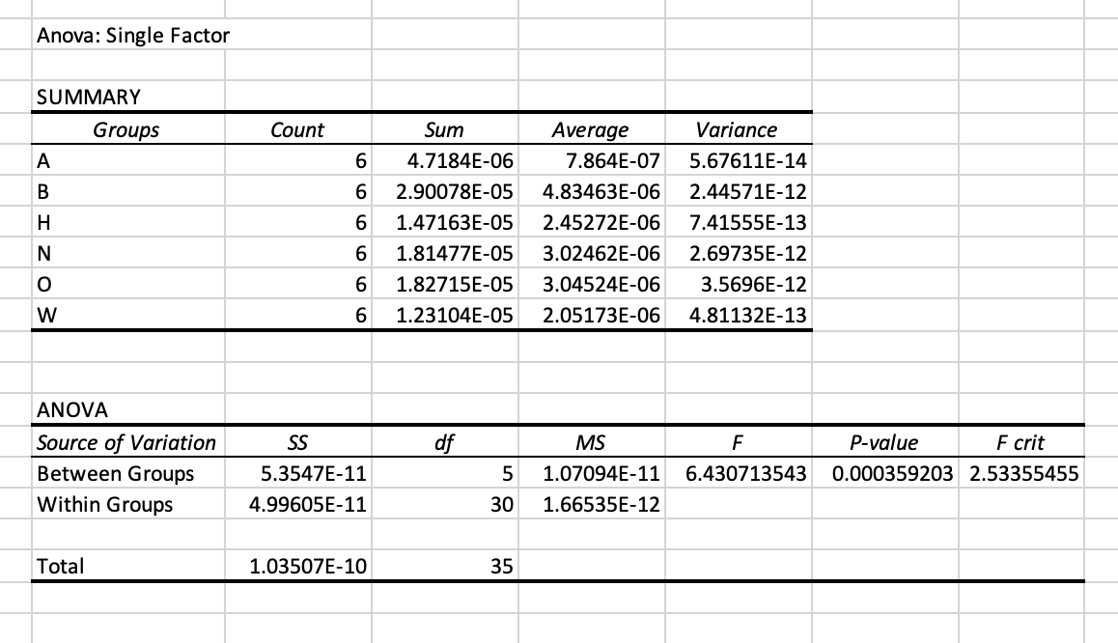
ANOVA Regression (95% CI)
H0:Avg of (A)=Avg of (B)=Avg(H)=Avg(N)=Avg(O)=Avg(W)
H1: At least one of the averages is different from the others
P Value of .000359 < P Value .05 : Reject the null
Conclude: Averages of shootings per race are different

Slide 17
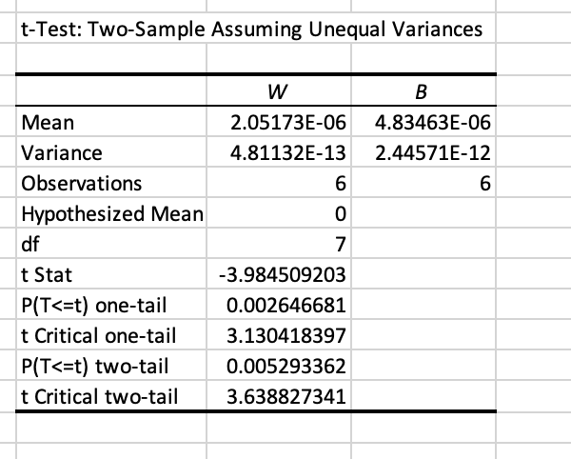
ANOVA Post-Hoc Regressions
Post-Hoc of White & Black
Two Tail P Value of .0052 < P Value of .0083
Conclusion: Reject the null

Slide 18
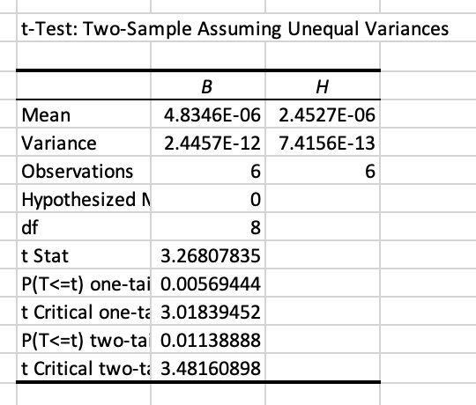
ANOVA Post-Hoc Regressions
Post-Hoc of Black & Hispanic
Two-Tail P Value of .011 > P Value of .0083
Conclude: Fail to reject the null

Slide 19
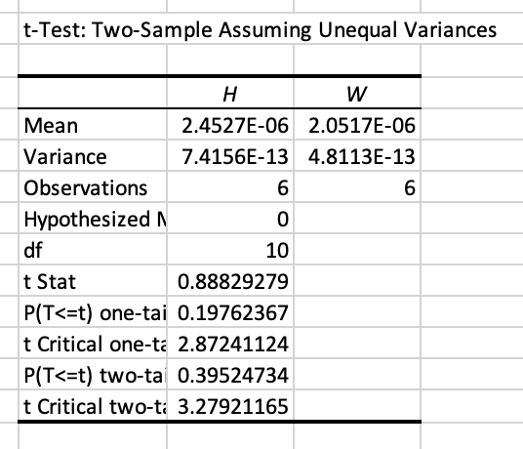
ANOVA Post-Hoc Regressions
Post-Hoc of Hispanic & White
Two- Tail P Value of .395 > P Value .0083
Conclude: Fail to reject the null

Slide 20
Conclusion
We can conclude from the ANOVA and ANOVA Post-Hoc regressions the following:
ANOVA: The averages of shootings per race are different
ANOVA Post-Hoc (White &Black): The averages of shootings are different
ANOVA Post-Hoc (Black & Hispanic): The average of shootings are the same
ANOVA Post-Hoc (Hispanic & White): The average of shootings are the same

Slide 21
Thank You!

